Slide 1



Presentation XIII
Bone Tissue Phantom
Thu Ta Zaw
2415121095

Slide 2

Experiment Timeline
Task | Validate Integrating Sphere | Validate IAD Method | Specimen Preparation | Measurement and IAD | Writing Result
April
May
Jun
July
August

Slide 3
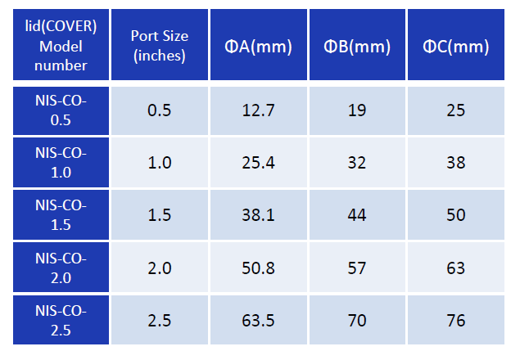

Specimens size for Integrating Sphere Measurement
Ex Vivo Optical Properties Estimation for Reliable Tissue Characterization
The size of the sample should be slightly larger than the size of the port diameter ensuring the sample completely covers the port to prevent light leakage.
Freshly excised biological samples representing soft and thin tissues (skin, skull, liver and muscle) were used with size of (2x2 ${cm}^{2}$).
For the thickness, samples should keep thin, typically under 3 mm, to avoid significant beam displacement during transmittance measurements.
The thickness of each samples is 2+0.5 mm.
The recommend size for the specimen is (30Dx2) mm or (30x30x3) mm.
Table. Ports size of the ND-Seiko Integrating sphere

Slide 4
3D printed ABS Optical Bone Phantom
Three-dimensional printed optical phantoms with customized absorption and scattering properties
Commercially available thermoplastics provide only a small range of physiologically relevant absorption coefficient (µ_{a})and reduced scattering coefficient (µ_{s}’) values.
The object of this research is to fabricate and validate customizable acrylonitrile butadiene styrene (ABS) filaments for dual extrusion 3D printing of tissue mimicking optical phantoms.
µ_{a} and µ_{s}’ values were adjustable by incorporating nigrosine and titanium dioxide in the filament extrusion process.
A wide range of physiologically relevant properties was demonstrated with average repeatability with 11.5% for µ_{a} and 7.71% for µ_{s}’ .
Advantages
3D printing with user defined optical properties may provide a viable method for durable optically diffusive phantoms for instrument characterization and calibration.
Can mitigate the problem of Liquid phantoms and solidified materials often limiting the ability to control the geometry of the final product.

Slide 5
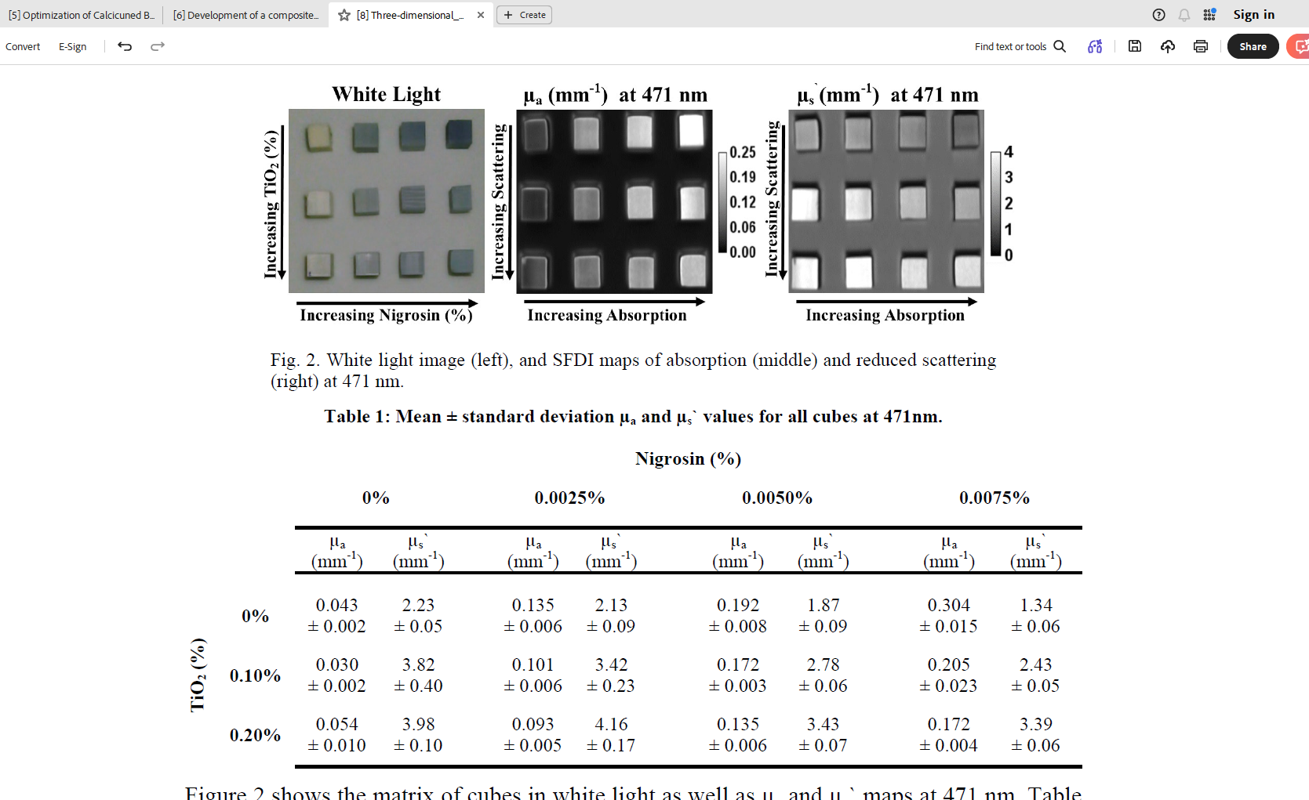
3D printed ABS Optical Bone Phantom
Three-dimensional printed optical phantoms with customized absorption and scattering properties
A key step to improving the versatility of 3D printed optical phantoms is the ability to alter the raw materials’ intrinsic optical properties to match that of a know target tissue.
The methodology to customized optical phantoms is the addition of absorbing dye, nigrosine, and scattering agent, titanium dioxide TiO₂ , prior to extrusion.
Fig. White light image (left), and SFDI maps of absorption (middle)
and reduced scattering (right) at 471 nm.
Table 1: Mean ± standard deviation µ_{a} and µ_{s}’ values for all cubs at 471 nm.

Slide 6
3D printed ABS Optical Bone Phantom
Development of a composite using calcined bone powder and silane cross-linked alginate as bone substitute material
Fig. Absorption, averaged overall TiO₂ concentrations, and reduced scattering, averaged overall nigrosine concentration
of all 3D printed cubes for 471,526,591,621,659,691,731
Absorption coefficient of human bone (µ_{a}) : 0.01 – 0.05 mm⁻¹
Scattering coefficient of human bone (µ_{a}) : 20 – 45 mm⁻¹
Reduced Scattering coefficient of human bone (µ_{a}) : 2.0 – 4.5 mm⁻¹

Slide 7
3D printed ABS Optical Bone Phantom
Development of a composite using calcined bone powder and silane cross-linked alginate as bone substitute material
Filament preparation
Co-extruding a mixture of commercially available natural color ABS pellets with custom absorption and scattering ABS “chips”. (combining ABS with either nigrosine and TiO₂)
Fabrication of TiO₂ chip consisted with dissolving the 20g of ABS in 50 ml of acetone for at least 12 hours. 0.2 g of TiO₂ was mixed with 1000 µl of water and sonicated for 10 minutes. After that add to the ABS solution. The mixture was then poured into a 21x21 cm pan to a layer thickness of 1.5 mm and vacuumed to remove air bubbles. The pan consisting of ABS/TiO₂ solution were left in the 40 kPa vacuum overnight to dry and solidify. Once it is solidified the thin sheet is cut into 2 x 2 mm dimension.

Slide 8
3D printed ABS Optical Bone Phantom
Development of a composite using calcined bone powder and silane cross-linked alginate as bone substitute material
Filament preparation
The nigrosine chips were also created using the same protocol described above by using the 0.02g of nigrosine and 800 µl of water.
Nigrosin and TiO₂ chips were mixed together prior to extrusion in the desired mass ratio and added to the hopper throughout the extrusion process to provide a more homogeneous filament product.
30 g batch of raw ABS pellets and chips yielded approximately two 2x2x2 cm 3D printed cubes.

Slide 9
Characterization of 3D printed PLA/PCL/TiO₂ Composites for Cancellous Bone
In this study, the ultimate tensile strength was modified by blending different ratio of PLA and PCL resulting in an optimum value of approximately 30 MPa when the ratio of PLA to PCL reached 3:1.
It is observed that the addition of 1% TiO₂ to the immiscible PLA/PCL composite increase in the tensile strength up to 37 MPa.
Upon examining the biocompatibility of PLA/PCL/TiO₂ composite, vigorous cell growth was observed.
The final composite has a comparable mechanical strength of the ideal cancellous bone structure.
Fig. 3D printed model of cancellous bone with PLA/PCL/TiO₂ composite

Slide 10
Characterization of 3D printed PLA/PCL/TiO₂ Composites for Cancellous Bone
PLA is cheaper option to make the bone graft as the process of grafting is expensive using metal is expensive, and it can reduce the problems related to metal’s higher strength (stress shielding) and toxicity.
As PLA and PCL are synthetic biodegradable thermoplastic polymer, it is compatible to use with human body and TiO₂ is an inorganic particle exhibiting suitable biocompatibility and it is well-known for non-toxic depending on size of the particle and condition of aggregation.
The Materials used in the study are as followed:
The Polylactic acid (PLA) was a commercial grade with density of 1.24 g/cc.
The Polycaprolactone (PLC) has a density of 1.15 g/cc.
TiO₂ has a density of 4.26 g/cc.

Slide 11
Characterization of 3D printed PLA/PCL/TiO₂ Composites for Cancellous Bone
Filament Preparation
To make the filament, a blend was prepared to make pellets with the desired composition.
The first blends made were a mixture of PLA/PCL with different composition (75/25, 50/50, 25/75 wt%).
The mixing process starts by first melting the corresponding amount of PLA due to its higher melting point. PCL is then added and when the blend is uniformly mixed, the filler is added and stirred until a homogeneous mixture is achieved.
The blend of the PLA/PCL 75/25 wt% showed the best characteristics and add the 1 wt% TiO₂ to the ratio.

Slide 12
Calcined bone Powder and silane-crosslinked alginate composite
Development of a composite using calcined bone powder and silane cross-linked alginate as bone substitute material
Calcined bone is an attractive natural material for use as bone substitute because of its cost-effectiveness and high biocompatibility.
The drawback of calcination process is that it can significantly weaken the mechanical properties.
In this research, calcined bovine bone powder reinforced with silane cross-linked alginate was prepared to assess its biocompatibility, osteo-conductivity, and mechanical compatibility which are the three critical, interrelated pillars for designing successful orthopedic implants and bone tissue scaffolds as bone substitute material.
The composite of calcined bone particle that contribute to mechanical rigidity and alginate fibers, a natural polysaccharide extracted from seaweed and a cost-effective , which provide fracture resistance.

Slide 13
Calcined bone Powder and silane-crosslinked alginate composite
Development of a composite using calcined bone powder and silane cross-linked alginate as bone substitute material
The demerit with alginate gel is when it is placed in body fluids, swelling of the gel occurs by leaching calcium ions from the gel which consequently deteriorate the mechanical properties of composite soon after transplantation.
Covalent cross-linking of alginate fibers occurs through 3-amino-propyltriethoxysilane promoted silane coupling and alginate spontaneously from apatite by incorporating calcium and phosphate ions from body fluids.
The hypothesis of the research is that the calcined bone powder/ alginate composite could obtain the necessary mechanical rigidity, mechanical stability in body fluids, and osteo-conductivity through silane coupling.

Slide 14
Calcined bone Powder and silane-crosslinked alginate composite
Development of a composite using calcined bone powder and silane cross-linked alginate as bone substitute material
Experiments
Observed the changes in simulated body fluids (SBF)
Cytotoxicity of the composite was tested using the cultured osteoblast cells by assessing the impact of the composite on cell proliferation, differentiation and bone matrix formation.
Results
No significant difference in mechanical properties was found between observation days from the initially measured maximum stress and elastic modulus of B/A-Si.
Regardless of the percentage of extraction fluid used, the cell viability was approximately 95%, equivalent to when fresh medium was used for cultivation, and no statistically significant differences were observed between groups and the composite has no effect on osteoblast proliferation.

Slide 15
Calcined bone Powder and silane-crosslinked alginate composite
Development of a composite using calcined bone powder and silane cross-linked alginate as bone substitute material
The mechanical properties of the composite were comparable to those of the human cancellous bone with good initial rigidity and adaptability.
There properties remained relatively stable even after 2 weeks of immersion in SBF and did not deteriorate significantly.
B/A-Si is not toxic to osteoblasts and has no noticeable effect on cell proliferation.
It can decrease in ALP activity, however, in contrast, B/A-Si included the formation of noncellular apatite.
X-ray diffraction analysis of the calcined bone powder showed a similar spectrum to those of hydroxyapatite.
The FTIR spectrum of the calcined bone powder was similar to that of hydroxyapatite (Hap), a mineral composed mainly of phosphorus and calcium, naturally occurring in human bones and teeth, which is highly scattering.

Slide 16
The End
THANK YOU FOR LISTENING
Thu Ta Zaw
2415121095

